Slide 1
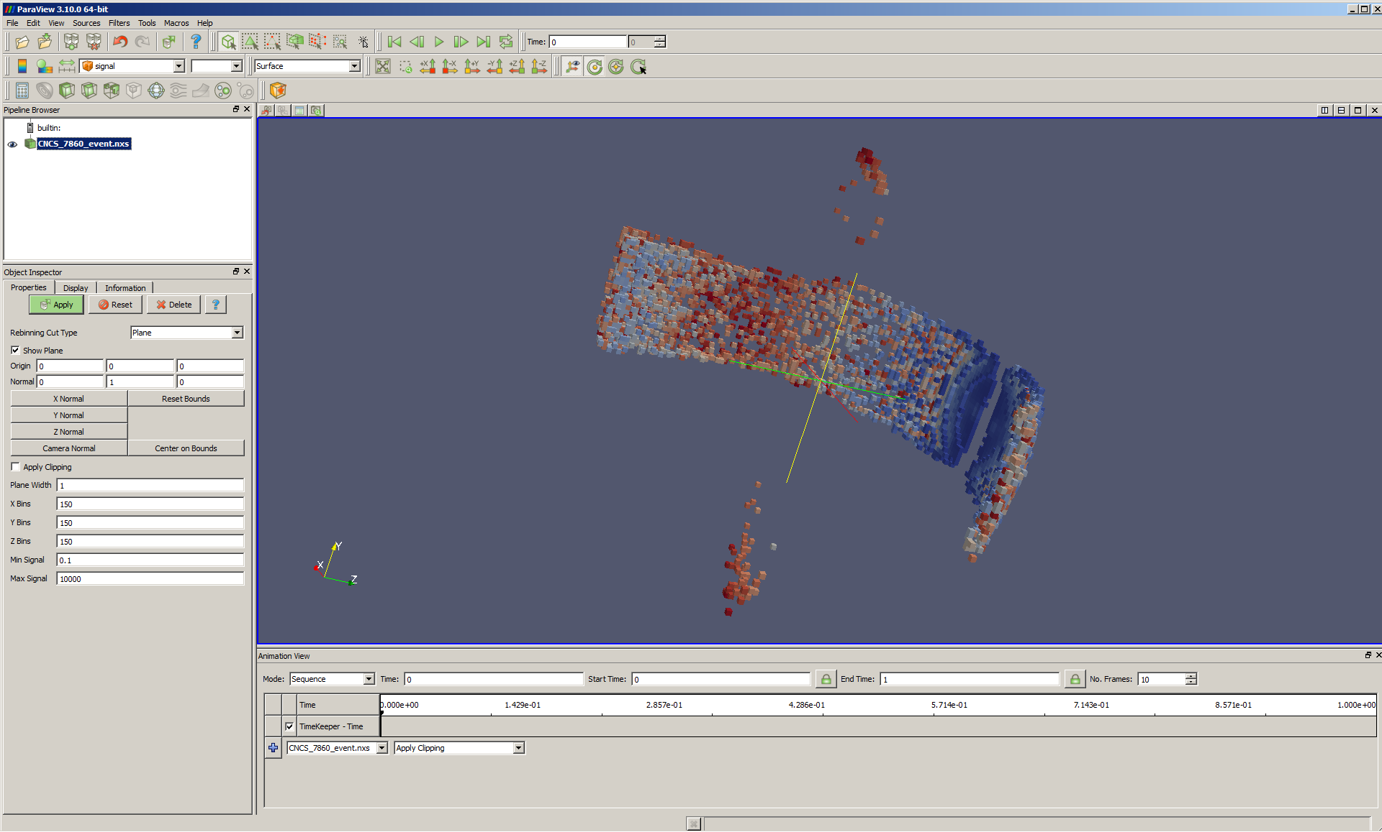
MDEvent Dynamic Rebinning

Slide 2
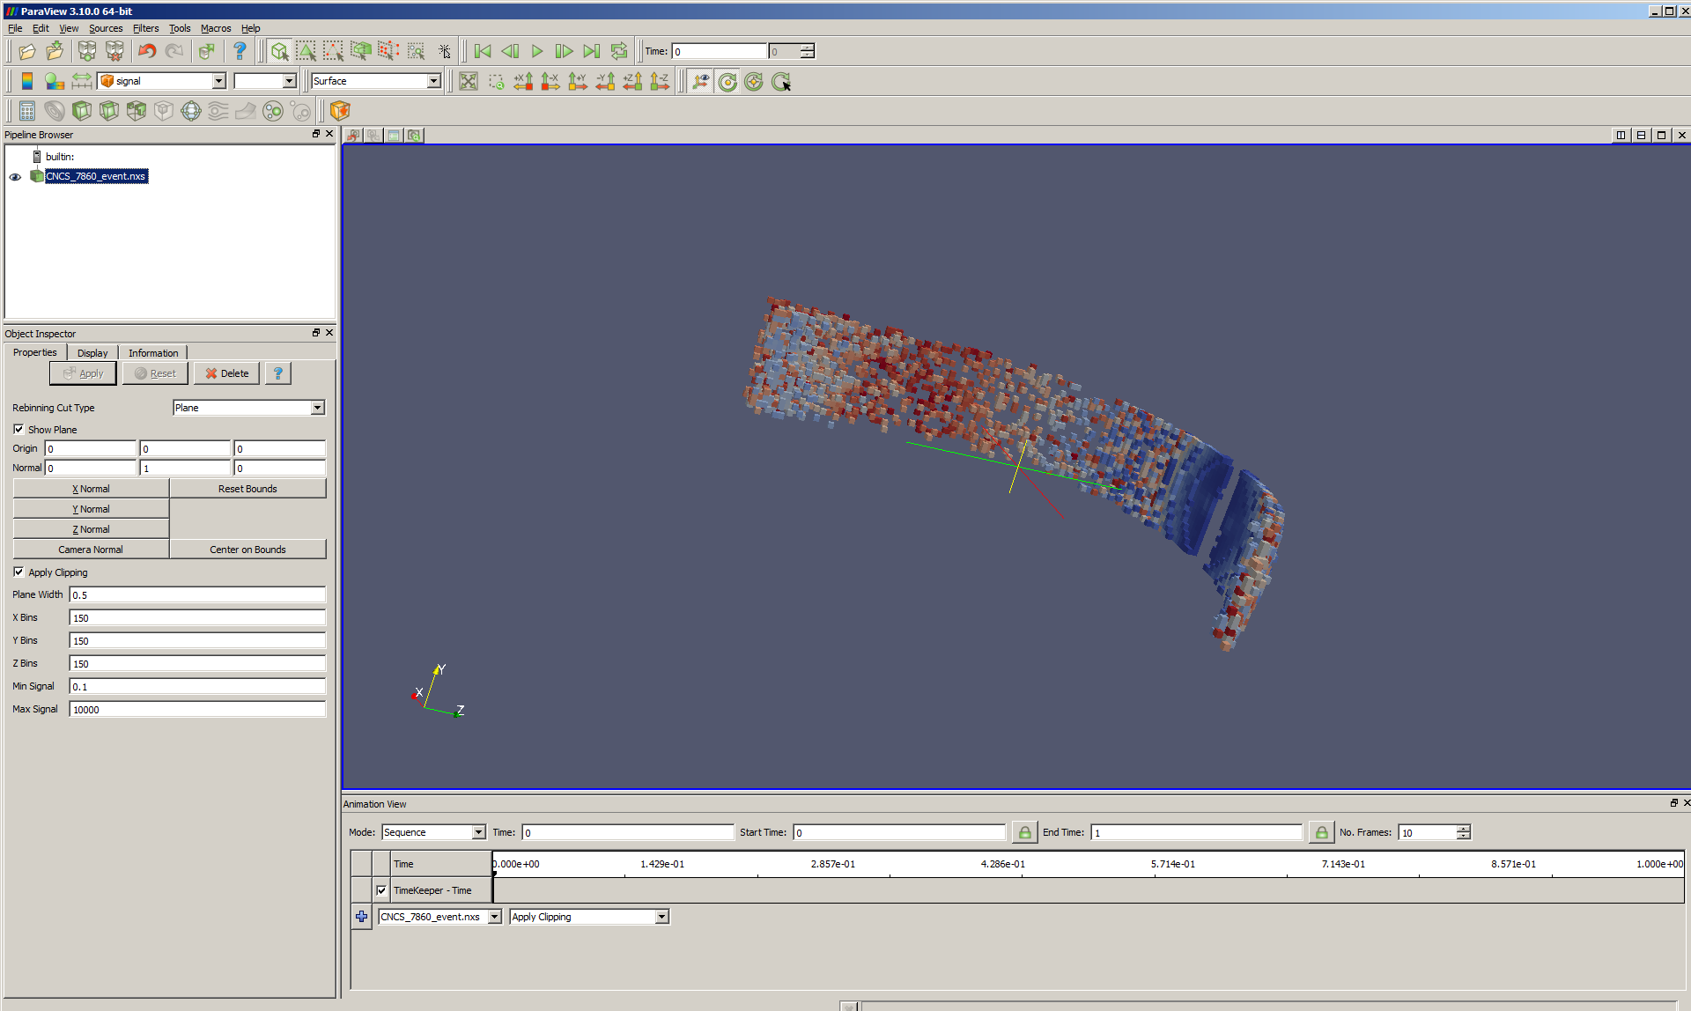
Using PlaneImplicit Function

Slide 3
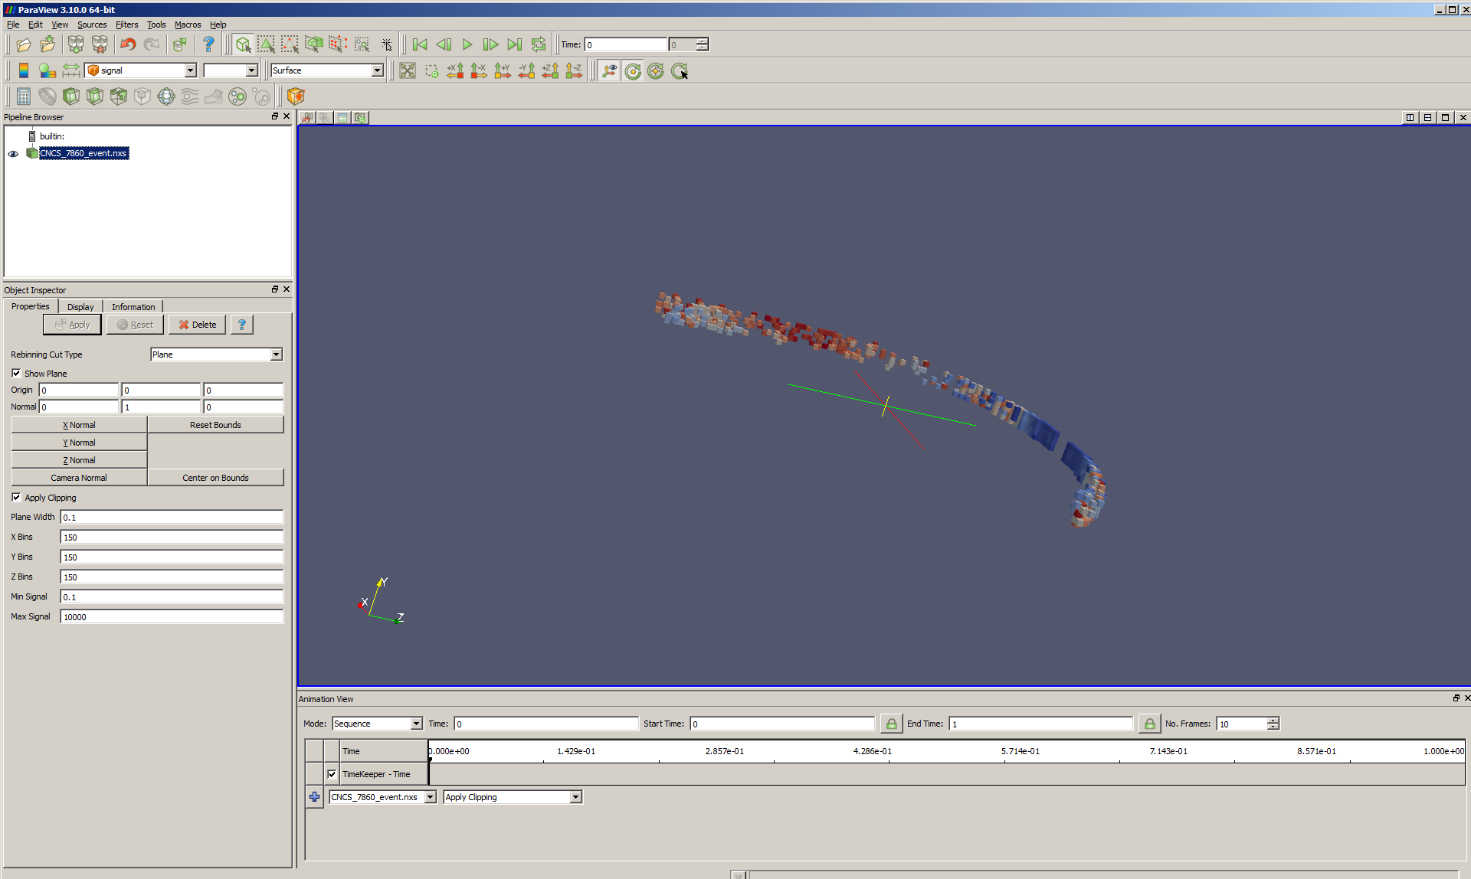
Reducing Plane Width

Slide 4
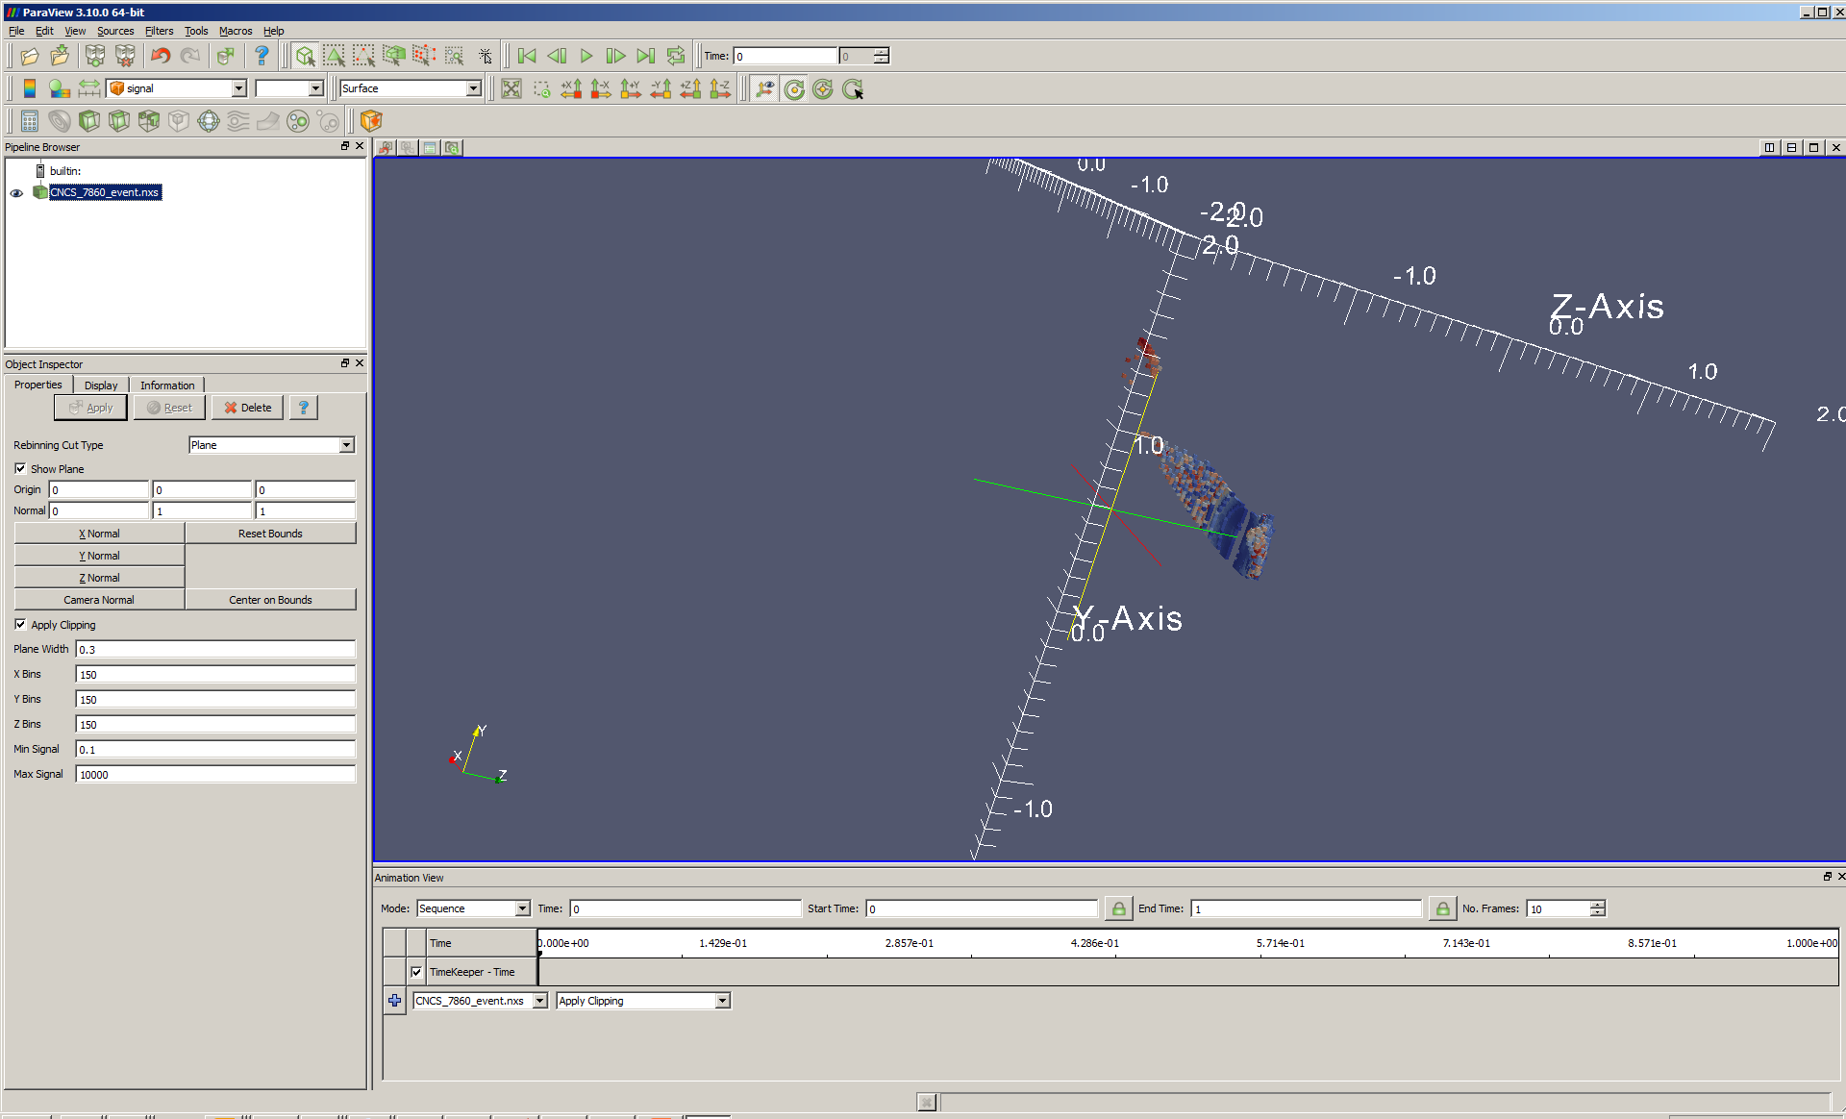
Non-axis aligned (1 1 0)

